Slide 1
Why Are Indian Children So Short? The Role of Birth Order and Son Preference
By Seema Jayachandran and Rohini Pande, 2017
Presented by Jack Slezak

Slide 2
Outline
Introduction
Background and Data Description
Birth Order and Child Outcomes
Culture and Height Deficits
Within-India Evidence
Favoritism Toward Eldest Sons and Birth Order Gradients
Implications of Son-Biased Fertility-Stopping Behavior
Sex Selection as a Potential Confounder
Alternative Explanations
Impact on Average Height
Conclusion
Opinions

Slide 3
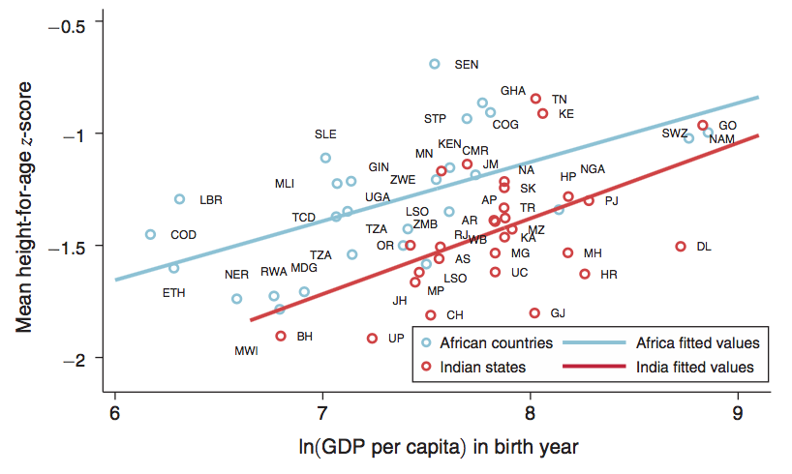
Introduction
25% of children around the world younger than 5 years old are short enough to be considered “stunted”; this rate is 40% India, which is worse than even poorer countries
Child stunting is key indicator of child malnutrition
Data from survey on 168,000+ Indian children and 25 African countries show significant height drop-off for later born Indian children
This drop-off is reflected in other health measures, like weight
Authors control for maternal and environmental characteristics when developing child height gradients for India and Africa

Slide 4
Introduction
Underlying mechanism to this steep height birth order gradient is eldest son preference – parents’ desire to have at least one son and for the son to be healthy
Traces back to patrilineal Hindu kinship system (Hinduism has a strong presence in India)
Lack of phenomenon in matrilineal areas supports this
Another possible mechanism: fertility-stopping behavior
When daughter is born, parents want to have more kids than originally intended to ensure they have son, leaving less resources per child
First mechanism creates an obvious height birth order gradient among boys; both mechanisms contribute to birth order gradient among girls
The presence of this steep height gradient lessens the average height of Indian children, due to diminishing returns on child height from inputs

Slide 5
Background and Data Description
Height is the most widely used measure of health (or lack thereof) since it’s easy to measure and stunting is strongly indicative of poor long-term health outcomes
Definition of being “stunted”: height-for-age z-score <= -2
2005-06 National Family Health Survey (NFHS-3) is the primary data source for India; Demographic and Health Surveys (DHS) is primary source for Africa (2004-10)
All children surveyed are 5 years old or younger
Also collected data on prenatal and postnatal care taken in both India and Africa (number of prenatal care visits, tetanus shots, iron supplements, etc.)
Due to sheer number of countries surveyed, Africa has sample size roughly 3x that of India

Slide 6
Background and Data Description

Slide 7
Birth Order and Child Outcomes
Indian children are 0.08 St. Dev. shorter than African children, which is significant at 1% level; if adjusted for PPP-adjusted GDP, deficit increases to 0.16 St. Dev.
Strong deficit in height emerges after second child and widens thereafter

Slide 8
Birth Order and Child Outcomes
Authors disaggregate height deficit by birth order; come up with following model to estimate HFA for child i born to mother m in country c:
Alpha coefficients represent effect on height from being Indian child and being second-born (α2), for example
X_{imc} is a vector of controls that include child age dummy variables to account for nonlinear patterns of z-scores and age
Key findings: a2 = -0.14 and is SS; sum of a1+a3 is -0.28 and is SS as well

Slide 9
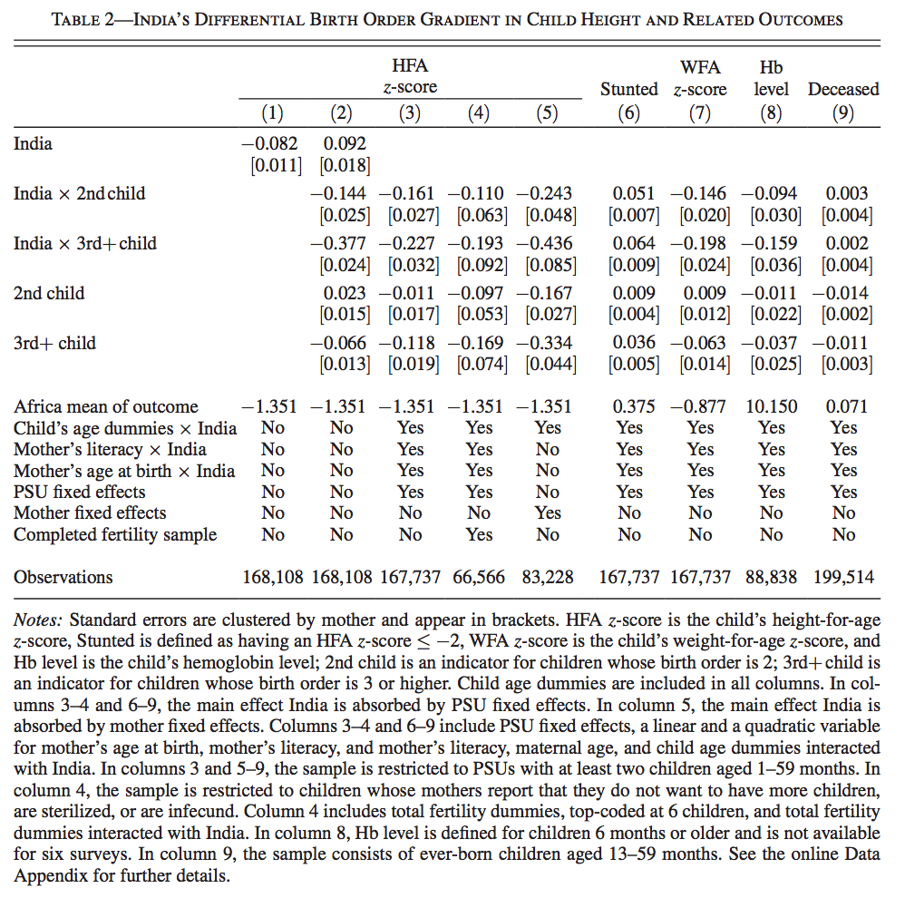
Birth Order and Child Outcomes

Slide 10
Birth Order and Child Outcomes
Ideally, data would use households that were done having kids and they would be able to obtain the heights for all children; this would ensure that there would be no confounding effects between birth order and family size
Actual and desired fertility are different in these countries because access to contraception is very limited, therefore regressions can’t control for total family size in general, raising an omitted variable bias concern; higher birth order children are more likely to come from larger families, and family size could affect child height via its effect on available resources per child
Possible solution to this concern is to include family fixed effects
Multiple steps taken to address endogeneity – risk of correlation between independent variable and error term in a model
To make sure Africa’s height gradient wasn’t unusually shallow, authors checked India’s gradient against many countries within a range of India’s GDP and still found India’s gradient to be significantly stronger

Slide 11
Birth Order and Child Outcomes
For all pre- and postnatal input measures except “Mother’s total tetanus shots”, there was a SS decline with birth order for India
Essentially reflects a general decrease in care for younger children in India, regardless of child stage

Slide 12
Culture and Height Deficits
Religious makeup of India is strong driver of birth order gradient; India is ~80% Hindu
Authors identify subgroups within India where eldest son preference is less prevalent to see if gradient still exists
To see if gradient is muted with these groups, use equation similar to equation 1 except indicator for India is replaced by indicator for low-son-preference subgroup
First examine matrilineal Indian states of Kerala and the eight Northeastern states, and comparing them with India
Average child heights in these states exceeds those for the rest of India, and the birth order gradient is substantially more muted
Next examine heterogeneity by child sex ratio; ratio increases for greater male proportion
Low-sex-ratio regions found to have shallower birth-order-gradient and higher average height

Slide 13
Culture and Height Deficits
Lastly, the authors examine gradient differences by religion
Islam places less emphasis on needing son for religious ceremonies and inheritance rules are less patrilineal than Hindu ones
Accordingly, son preference is weaker and that’s reflected by less skewed sex ratio and smaller gender gap in mortality rate
Importantly, found that Muslim Indians have much more muted birth order gradient in both HFA and WFA than Hindus for birth order 3 and higher
Worth noting that Muslim children have relatively lower HFA and WFA scores, implying that they’re likely poorer than average families, and when total inputs are lower, they’re more evenly distributed

Slide 14
Culture and Height Deficits
The authors also use the DHS sample to test multiple predictions that follow if the height gradient stems from eldest son preference
PREDICTION 1: Relative to African counterparts, both boys and girls in India will exhibit a steeper birth order gradient
Intuition behind this is obvious for boys; gradient would be absent if parents simply had general son preference
For girls, eldest-son preference disfavors later-born girls through sheer number of siblings as well as adjusted fertility expectations when daughters are born before sons

Slide 15
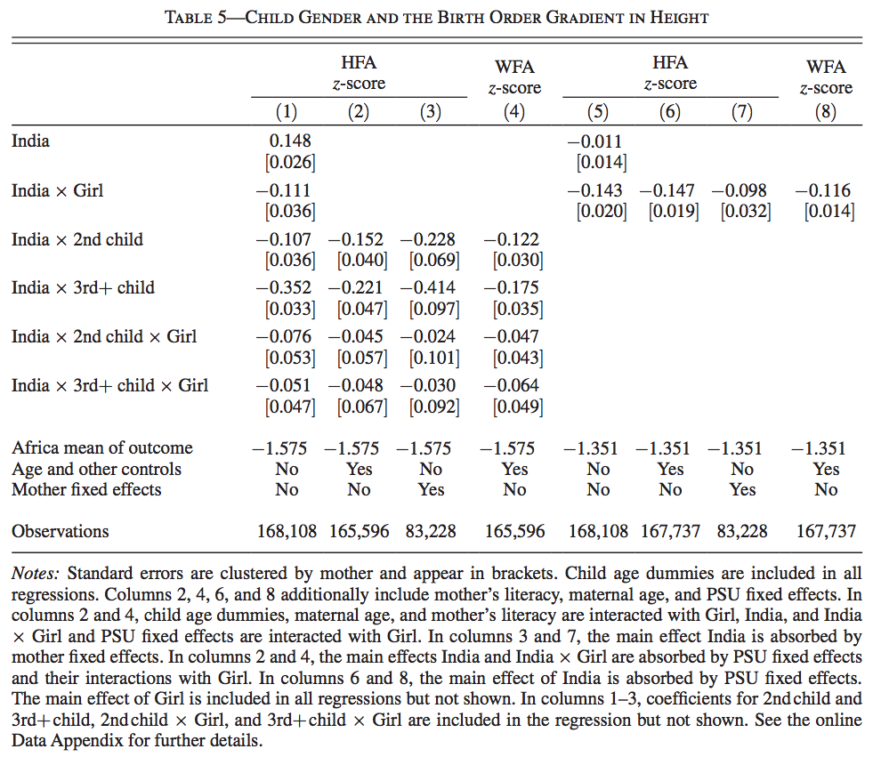
Culture and Height Deficits
Steep gradients for both Indian boys and girls; triple interactions of India, higher birth order and if(girl) are negative and SS
Unlike the case for boys, there’s no SS height advantage for firstborn girls
Important result from these findings are that first-born Indian boys are 0.15 z-scores taller than first-born boys from Africa, on average

Slide 16
Culture and Height Deficits
Although gradients in table 5 don’t differ a lot by gender, there are 2 possible reasons that one could expect a parallel/level difference in height by gender in India:
1) If eldest sons receive more resources than everyone else, sons will on average receive more than daughters
2) In India, birth of daughter in family of girls often increases mother’s desire to have more children (they want that son), so larger families are more likely to be daughter-heavy and they generally have less resources per child
PREDICTION 2: The India-Africa height gap will be more pronounced among girls
Evidence supporting this prediction is shown in Column 5 of Table 5
This gender impact raises the question of whether the birth order gradient and height gap are driven by eldest son preference or simply general son preference

Slide 17
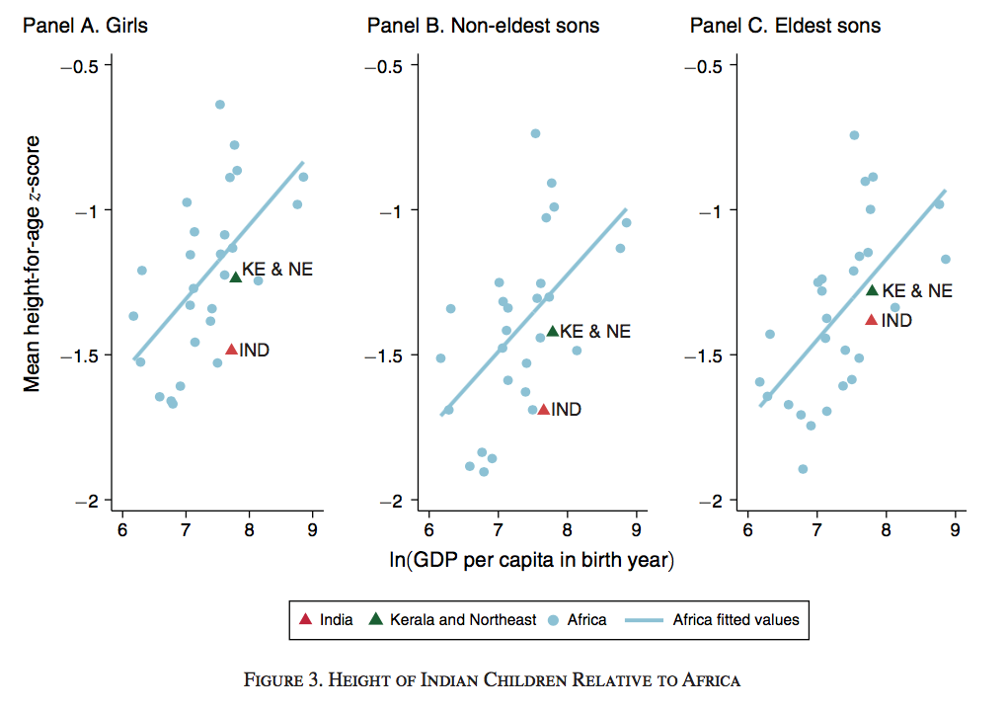
Culture and Height Deficits
Although both forms of son preference seem present, eldest son preference is the primary driver behind the birth order gradient, as proven in Figure 3
Both non-eldest sons and girls show greater improvement in matrilineal states vs. India than eldest sons do; if preference in rest of India was mostly son-general, we would only see dramatic improvement in girls here.

Slide 18
Culture and Height Deficits
PREDICTION 3: Relative to African counterparts, later parity girls with no older brothers in India face larger disadvantages in postnatal than prenatal investments
Reflects Indian parents using “try again” mechanism once it’s discovered that child is female; prenatal inputs reflect parents not yet knowing gender of child
Table 6, Columns 1&2 show results from regressions estimated at the input level for the sample of girls, distinguishing between pre- and postnatal inputs
The coefficient for India*PrenatalInput*NoElderBro is positive and SS (parents give lots of prenatal inputs when they don’t already have sons), and sure enough, the coefficient for India*NoElderBro is negative and SS, showing that less postnatal inputs are allocated for daughters without older brothers

Slide 19
Culture and Height Deficits
PREDICTION 4: Relative to African counterparts, outcomes for Indian children will vary with sibling composition and birth order as follows:
(i) If fertility stopping effects dominate sibling rivalry effects, then later parity girls w/no older brothers will show larger height deficits
(ii) High birth order eldest sons fare worse than eldest sons born at lower birth order
To test (i) the authors estimate a model based on equation (2) but add interactions with the variable NoElderBro; they found that the I_{C}*NoElderBro coefficient, which corresponds to an eldest son being born, is positive. Whereas, the I_{C}*Girl*NoElderBro coefficient, which corresponds to being a girl with only older sisters, is negative (Table 6, Column 3)
This shows that son-biased fertility mechanism slightly dominates sibling rivalry
Column 3 also reflects results of part (ii) of Prediction 4: Ic + Ic × 2ndChild + Ic × NoElderBro, which gives relative height advantage for eldest Indian sons being 2nd child born, is positive and SS. However, this same variable for the third child is negative, which is in line with (ii), assuming that most Indian families plan on having two children

Slide 20
Culture and Height Deficits

Slide 21
Culture and Height Deficits
Possible issue with sex-selective abortions having higher occurrence in India than Africa being a confounding factor to son-biased fertility stopping; authors provide multiple reasons that they think this isn’t a major issue
Possible alternative explanations for significantly steeper height gradient in India:
Maternal Health: Indian mothers are on average shorter than African mothers
Disease Environment: possibility of high rate of open defecation in India as contributor to child stunting, as younger children get exposed to more pathogens from their older siblings
Communal Child-Rearing: having older siblings reduces the time parents can devote to their youngest children; this is less of an issue in Africa, where tight-knit communities help raise children
Land Scarcity: There is more land available in Africa, so African parents may value of their children more equally since they need larger number of children to help them
All of these are checked by authors and are not deemed significant to gradient

Slide 22
Impact on Average Height
Does the gradient play a role in the average height gap between children in India and Africa?
The within-India comparisons provide supportive evidence of this; the Indian subgroups with less eldest-son preference not only had shallower gradients, but also higher average heights
Data from IHDS show child height having diminishing returns to household income and expenditures, meaning families with less equal resource distribution will generate lower average heights
In attempt to quantify impact of height gradient on average height, they observe the correlation between these two things across all of the countries used in the African subsample (the gradient steepness is measured by one value that proxies the coefficients for the 2nd and 3+ children)
Gradient depresses average height by 0.106 z-score points out of the 0.162 z-score gap between Indian and African children (65%)

Slide 23
Conclusion
This paper compares children’s height-for-age in India and Africa to highlight the abnormally high rate of stunting that occurs in India; there is ample evidence to suggest that allocation of resources within the family is a key contributor to this
First, the height disadvantage in Indian children appears for second born children and those of a higher birth order.
Second, investments in following pregnancies and later children decline faster in India
The primary mechanism that the authors suggest as a driver to this steep birth order gradient in child height is eldest son preference
There is hope that this trend could become obsolete once India develops more and a greater amount of resources become available to all, but there is evidence to indicate that this birth order preference has existed over time, as well as India’s high stunting rate, so we don’t know when a realistic end could arrive

Slide 24
Opinions
Paper made strong considerations of possible fallacies to its arguments and typically provided some sort of defense every time
The regressions following each prediction helped solidify the authors’ theory that eldest son preference was a strong mechanism here
Although the findings of this paper could certainly have an economic impact, I do not see strong connection between this paper and quantitative finance

